Slide 1
Drowsiness detection and alerting system
Tech freaks-
K.V.S. Haswanth
V. Swarna kumar
G.S.S.HARSHA

Slide 2
Introduction:
A majority of road related accidents are due to driver’s fatigue,distraction and drowsiness. Recently accidents are increased at large amount. Various new creative technologies are introduced to avoid and reduce these accidents. In these accidents, driver can meet severe injuries and even death. These may lead to significant economic loss. This system can reduce the road related accidents due to driver’s fatigue. Our main objective is to develop a model which can detect the driver’s drowsiness and indicate the driver’s condition by alarm. Here we provide a prevention technique using eye blink and where we can stop the vehicle to avoid collision of vehicle.

Slide 3

Do you know?
According to 2016 records, 4,552 accidents are occured due to driver’s drowsiness.
14,894 accidents are occured due to intake of alcohol by driver’s.

Slide 4
Existing System:
Present system alerts driver to take a break and have a cup of coffee.
In the existing system, the drowsiness is detected by the SVM(Support Vector Machine) .
This SVM classifies a sequence of video segments into alert or non-alert driving event.
Visual intelligence and Artificial Intelligence are being used in various systems.
This VI and AI detects the facial recognition and eye-blinking using image processing.

Slide 5
Proposed system:
We introduced alarming system when driver feels fatigue.
It also alerts the dearest ones of the driver about his/her state of consciousness.
An app to notify the members of the family about his drowsiness state.
Continuous monitoring of the driver using EAR(Eye-Aspect-Ratio) algorithm.

Slide 6
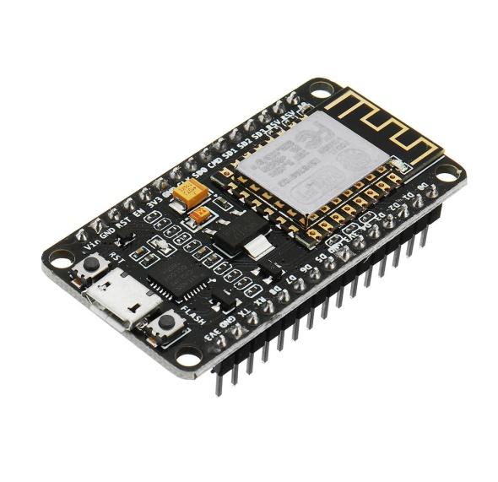
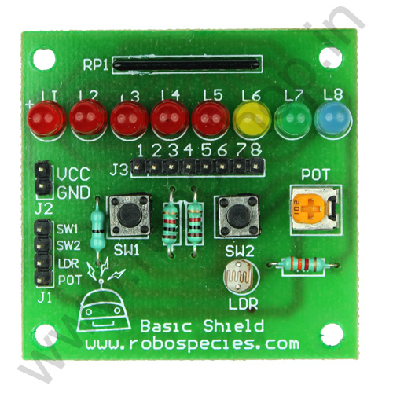
Hardware :
NodeMCU:
NodeMCU is an open source IoT platform. It includes firmware which runs on the ESP8266 Wi-Fi SoC from Espressif Systems, and hardware which is based on the ESP-12 module.
Basic Sheild:
This Basic Shield can be interface with 5V or 3.3V logic microcontroller boards like Arduino,8051,ARM etc.
Basic Shield is very popular shield for interfacing of electronics component with microcontroller like LED’s, variable resistor, Push Button, LDR, buzzer etc.

Slide 7




Software:
Spyder
Andriod studio
Arduino
IBM IOT

Slide 8
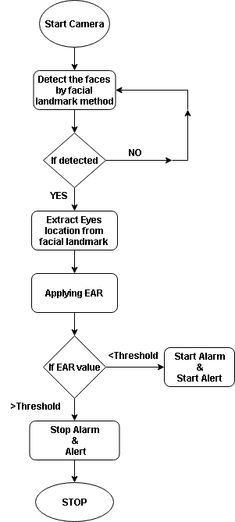
Algorithm:

Slide 9
Advantages:
Reducing the death rate of people.
Detects drowsiness.
Decreasing road accidents.
Implementation of system without using database storage.
Due to non obstructive nature of these methods they are more practically applicable.

Slide 10
Disadvantages:
It will not work with people having dark skin.
There should not be any reflective object.
It will not work if driver wears shades.

Slide 11
Solution:
Improving the AI algorithm for enhancing the detection performance.
Developing the system in such a way that the vehicle switching to auto mode.
Using high quality built in camera.

Slide 12
Future Scope:
Including image capturing technology.
Including alcohol detection sensor.
Including smoke detecting sensor.
Switching to auto mode.

Slide 13


